Slide 1
NPO Network Planning & Optimization
Competence Center Leader
Operations Support Center
2016 Competence Assessment Summary
05/23/2016

Slide 2
Actual Headcount vs Completed Assessment
100% of team completed the Competence Assessment
CCL | Actual HC | Completed Assessment HC
Cengiz | 53 | 53
Total HC in Competence Tracker | 53

Slide 3
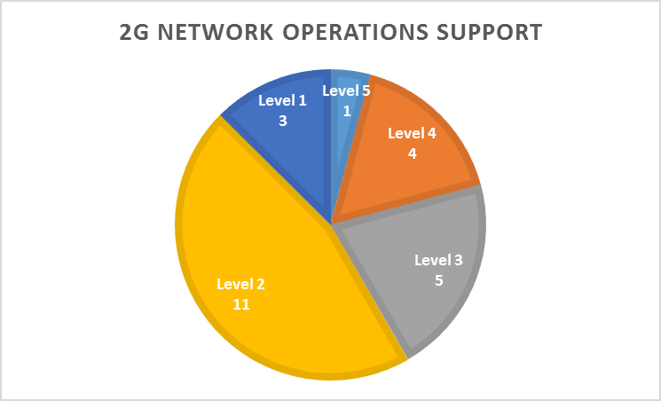
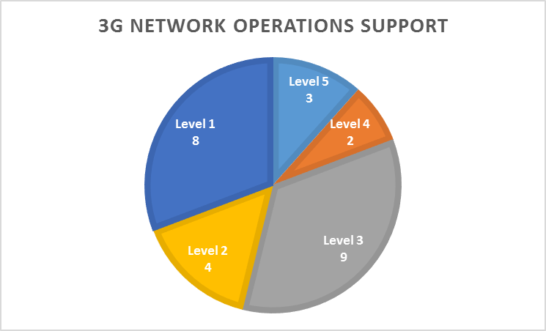
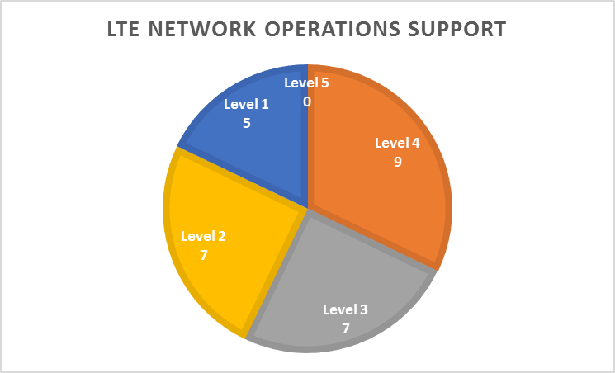
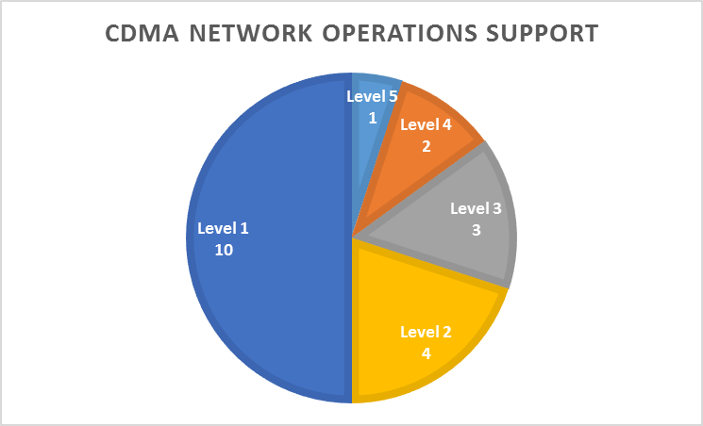
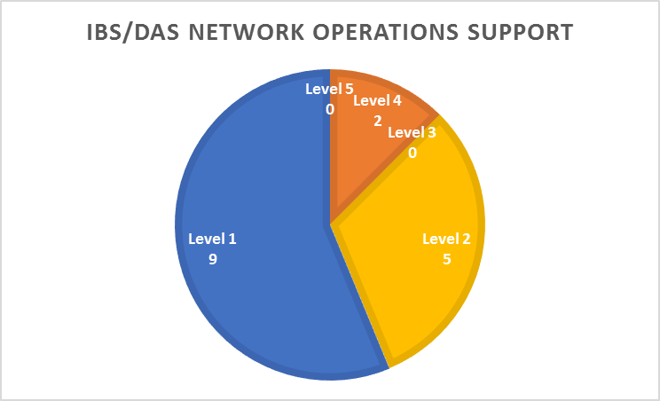
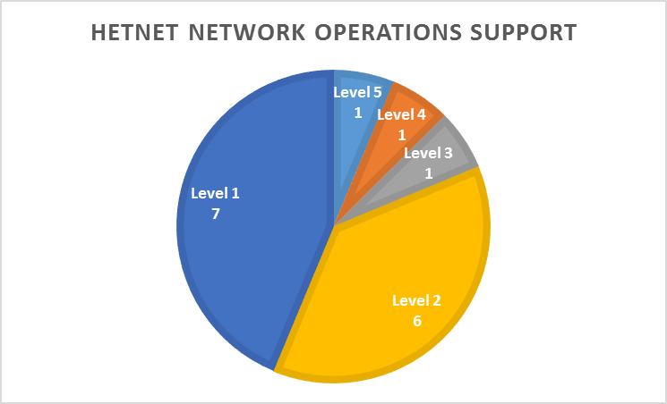
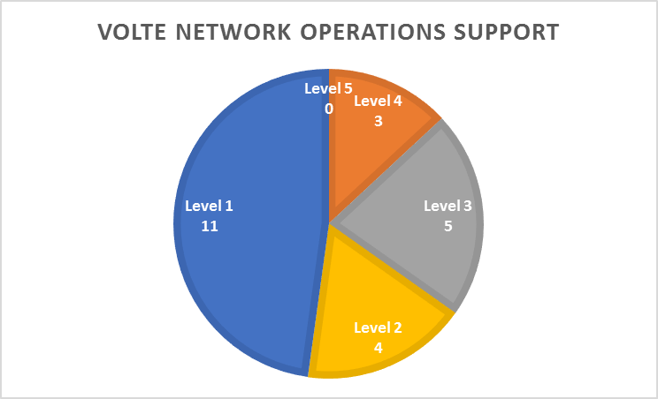
Nokia Competence Overview
Competence Level:
Level 5 - World Class
Level 4 - Advance
Level 3 - Intermediate
Level 2 - Basic
Level 1 - Initial

Slide 4
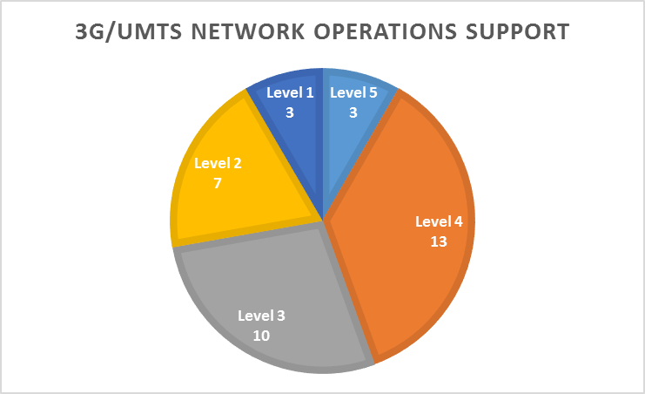
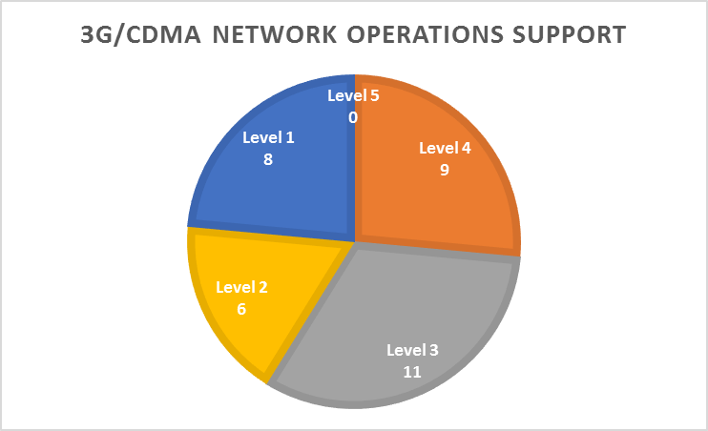
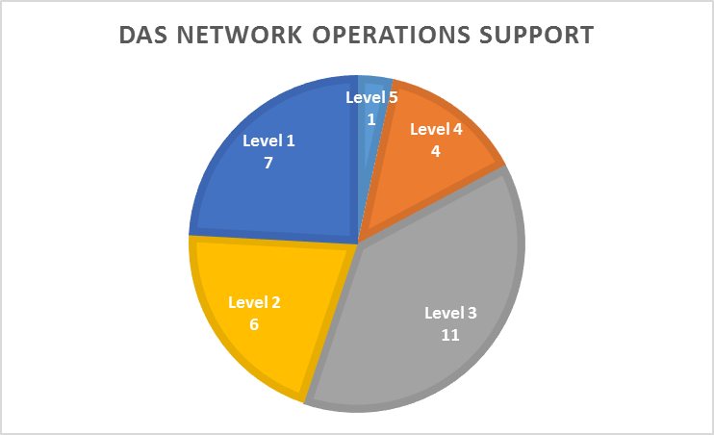
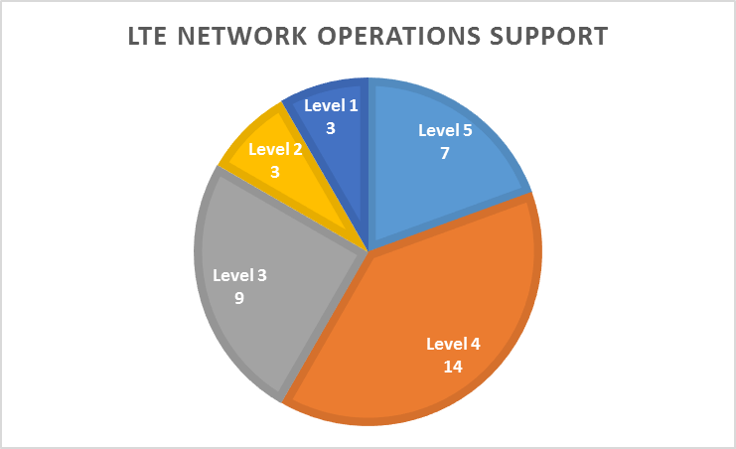
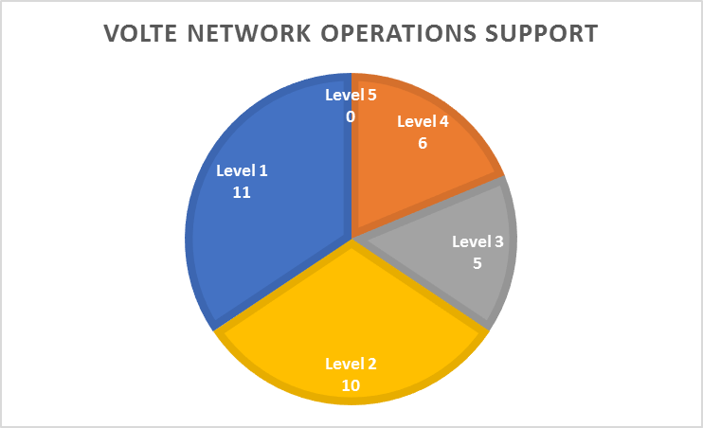
ALU Competence Overview
Competence Level:
Level 5 - World Class
Level 4 - Advance
Level 3 - Intermediate
Level 2 - Basic
Level 1 - Initial

Slide 5
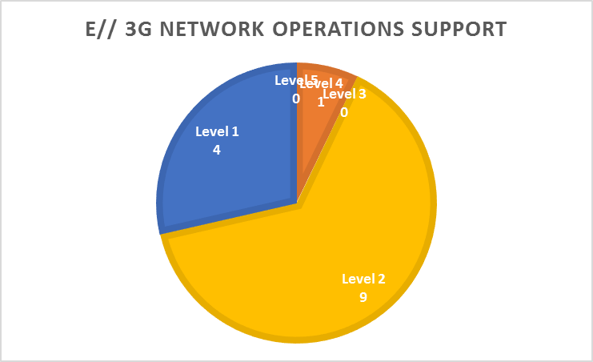
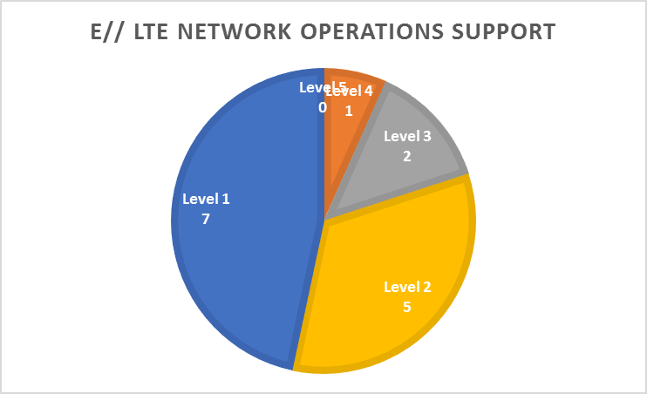
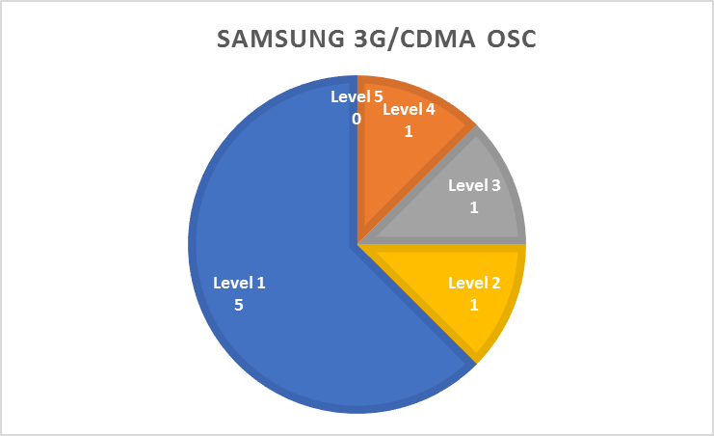
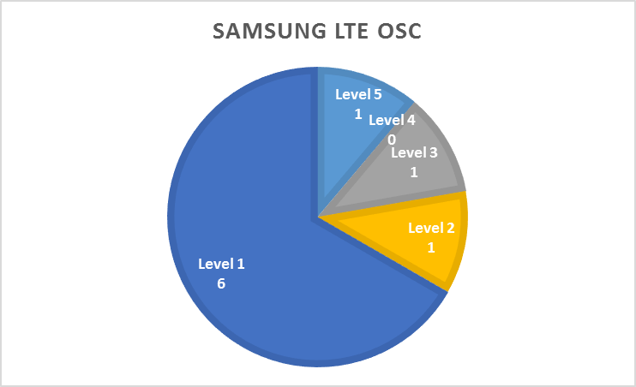
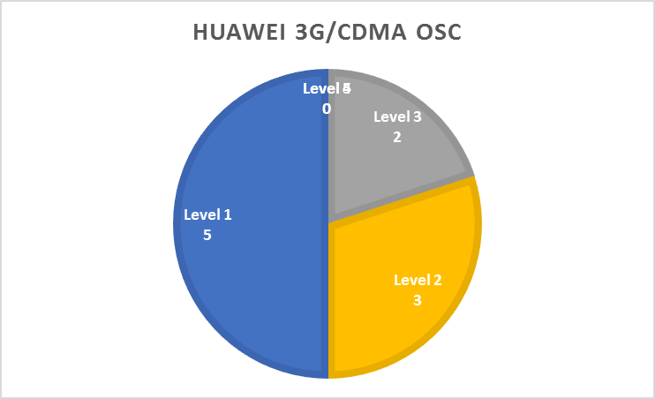
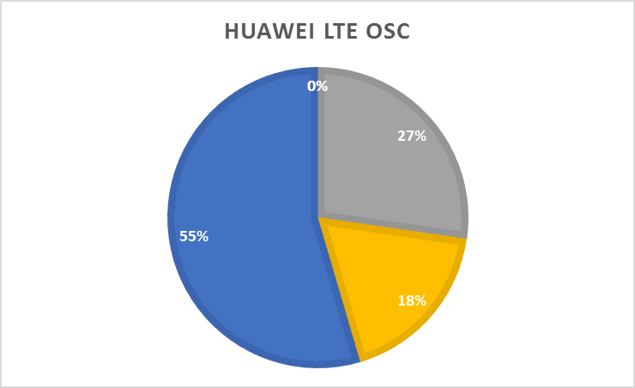
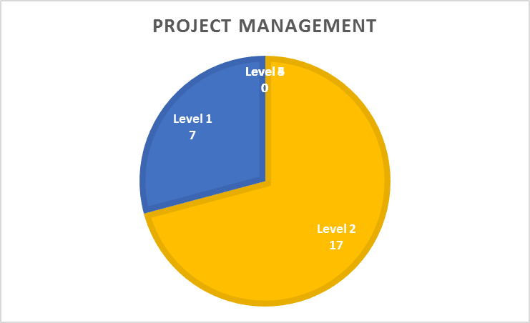
Multi-Vendor Competence Overview
Competence Level:
Level 5 - World Class
Level 4 - Advance
Level 3 - Intermediate
Level 2 - Basic
Level 1 - Initial

Slide 6
Competence Breakdown

Slide 7
Multivendor Competence Overview

Slide 8
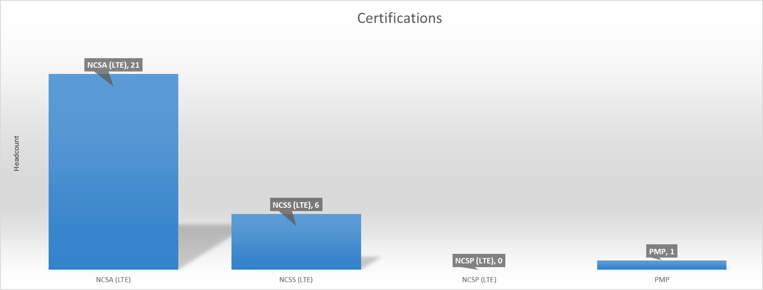
Certification
Total Headcount is 53.
Total of 21 (40%) are NCSA LTE Certified
Total of 6 (11%) are NCSS LTE Certified
Total of 0 (0%) are NCSP LTE Certified
Total of 1 (1.8%) are PMP Certified

